Slide 1

Read visualizer. Used to visualize SVs and generate statistics to describe SVs
svviz

Slide 2
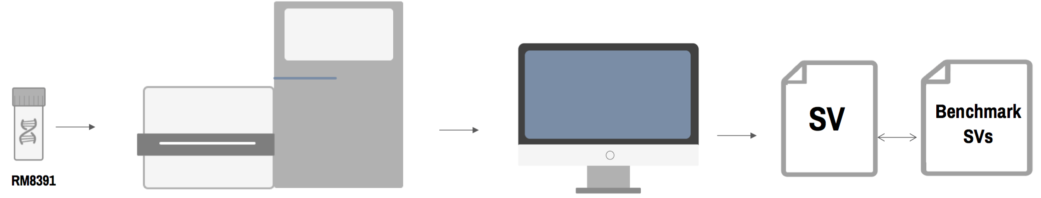
GrCH37
Union
VCF
BAM
SVVIZ

Slide 3
GrCH37
Union
VCF
BAM
SVVIZ
REF
ALT

Slide 4
GrCH37
Union
VCF
BAM
SVVIZ
REF
ALT
SV Image and Statistics

Slide 5
Example SVVIZ Output

Slide 6
Example SVVIZ Output
HG002 – AJ son
HG003 – AJ Father
HG004 – AJ Mother

Slide 7
Example SVVIZ Output
Heterozygous Variant

Slide 8
Example SVVIZ Output
Homozygous Reference

Slide 9
Example SVVIZ Output

Slide 10

Example SVVIZ Output

